Slide 1


Seminar Group 6 Team 5
Revitalizing LinkedIn:
A Machine Learning Approach to Enhance User Experience and Engagement
Jiang Lei (U2121557B)
Toh Jing Qiang (U2121442H)
David Tey Bo Yuan (U2121810J)
Nagammai Senthil Kumar (U2120146L)
Fong Ye Xuan (U2120767B)

Slide 2




Nagammai
Business Problem
Current Situation of the Labour Market
Current Situation of the
Job Market
Gap between Available Talents & Demand
Job Scams
Volatile Job Market characterized by constant changes in job requirements
102, 000 employees
laid off from U.S. based tech companies in 2023
(Ruby, 2023)
Unemployment
rate at 3%
vs
Number of Job vacancies at 104 500
More than 3500 instances of job scams recorded in 2022, leading to a loss of more than $58 million.

Slide 3




Nagammai
Business Problem
LinkedIn’s Position in Current Market
Business Opportunity
Threat
Many layoffs in the job market
Increase in the number of job seekers & job vacancies
Job seekers struggle to match their skills with changing job requirements
Golden opportunity for LinkedIn to address the gap & boost its business
Post-Covid
Limited in-person interactions has led to shift in remote working and rise of online job searching
Online Job Searching
Unemployment Rate (Cue, 2023)
Provides access to a wide range
of job postings online
3%
Vulnerable to Job Scams
Annual Job
Vacancies (MOM, 2023)
5.1%
70.8 million cases of job scams
Losses of over $1.6 million
(Zamost & Khorram, 2022)
Notes:
Job vacancies: https://stats.mom.gov.sg/Pages/Job-Vacancy-Summary-Table.aspx
Provides access to a wide range of job postings online -> more exposed
Job scams: https://www.cnbc.com/2022/06/17/fbi-says-fraud-on-linkedin-a-significant-threat-to-platform-and-consumers.html

Slide 4







Nagammai
Business Problem
Business Opportunity for LinkedIn
Security
Innovation
Effectiveness
Safeguard users
from job scam
Stand out from
competitors
Streamline recruitment
of passive job seekers
LinkedIn
Adaptability
Competitiveness
More adaptable to industry trends amidst the ever changing job market
Gain a competitive edge against its competitors

Slide 5









Nagammai
IntelliLink – Unified Analytical Solution
For Enhancing Security, Innovation & Effectiveness
Security
Innovation
Effectiveness
Current system mainly
flags out suspicious
accounts
Currently users are
encouraged to share
industry news
Currently only active
job seekers are more visible to recruiters through “open to work” feature
Current
Solution
System may leave
sophisticated scams
undetected
Users must navigate
changing job market
on their own
70% of workforce are
passive job seekers having
in-demand skills
Gap
Automate detection process by directly flagging suspicious job postings
Offer meaningful
metrics on the
market trend
Headhunter feature
to tap the untapped
pool of talents – passive jobseekers
Proposed
Solution
Notes:
Security: system may only catch a portion of fraudulent postings and miss others
focusing mainly on flagging out suspicious accounts does not directly address the issue of verifying the legitimacy of job listings.
scammers can still post fraudulent job listings, and the system may only catch the most obvious red flags,
leaving more sophisticated scams undetected.
As a result, job seekers may fall victim to these scams

Slide 6



Nagammai
Overview of IntelliLink
Security
Fraudulent
Job Listing Filter
IntelliLink
Logo
Industry Trend Forecasting
Passive Jobseeker Prediction
Innovation
Effectiveness

Slide 7
Jing Qiang
The Technology Behind IntelliLink
Fraudulent
Job Listing Filter
Industry Trend Forecasting
Passive Jobseeker Prediction
Security
Innovation
Efficiency

Slide 8
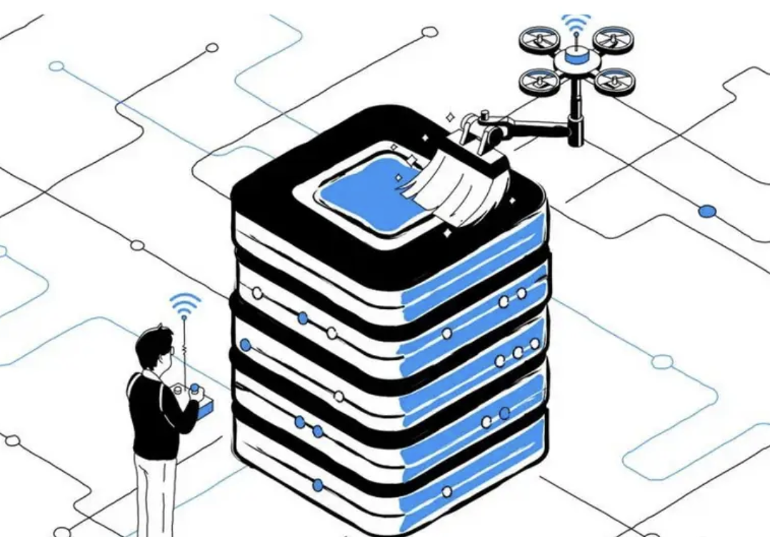



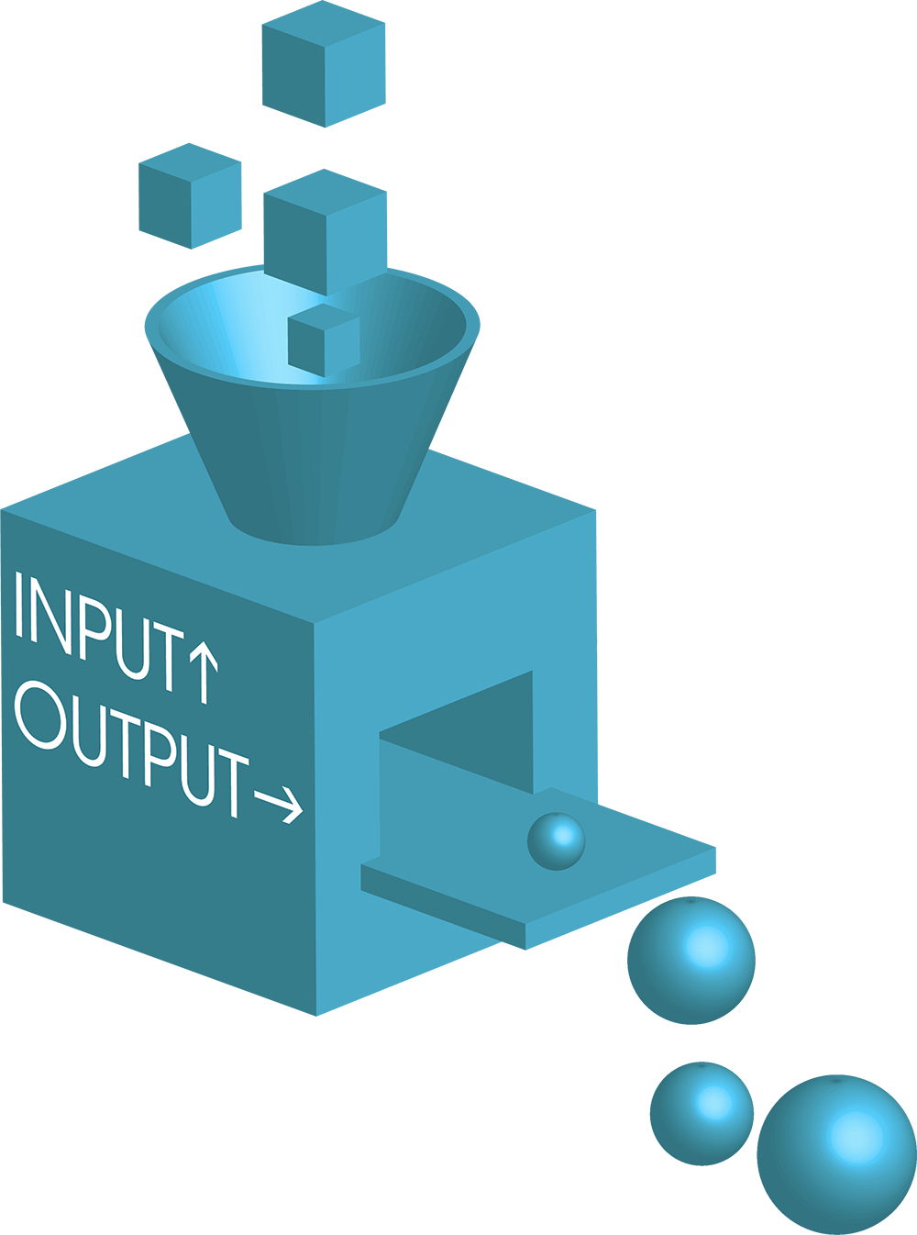
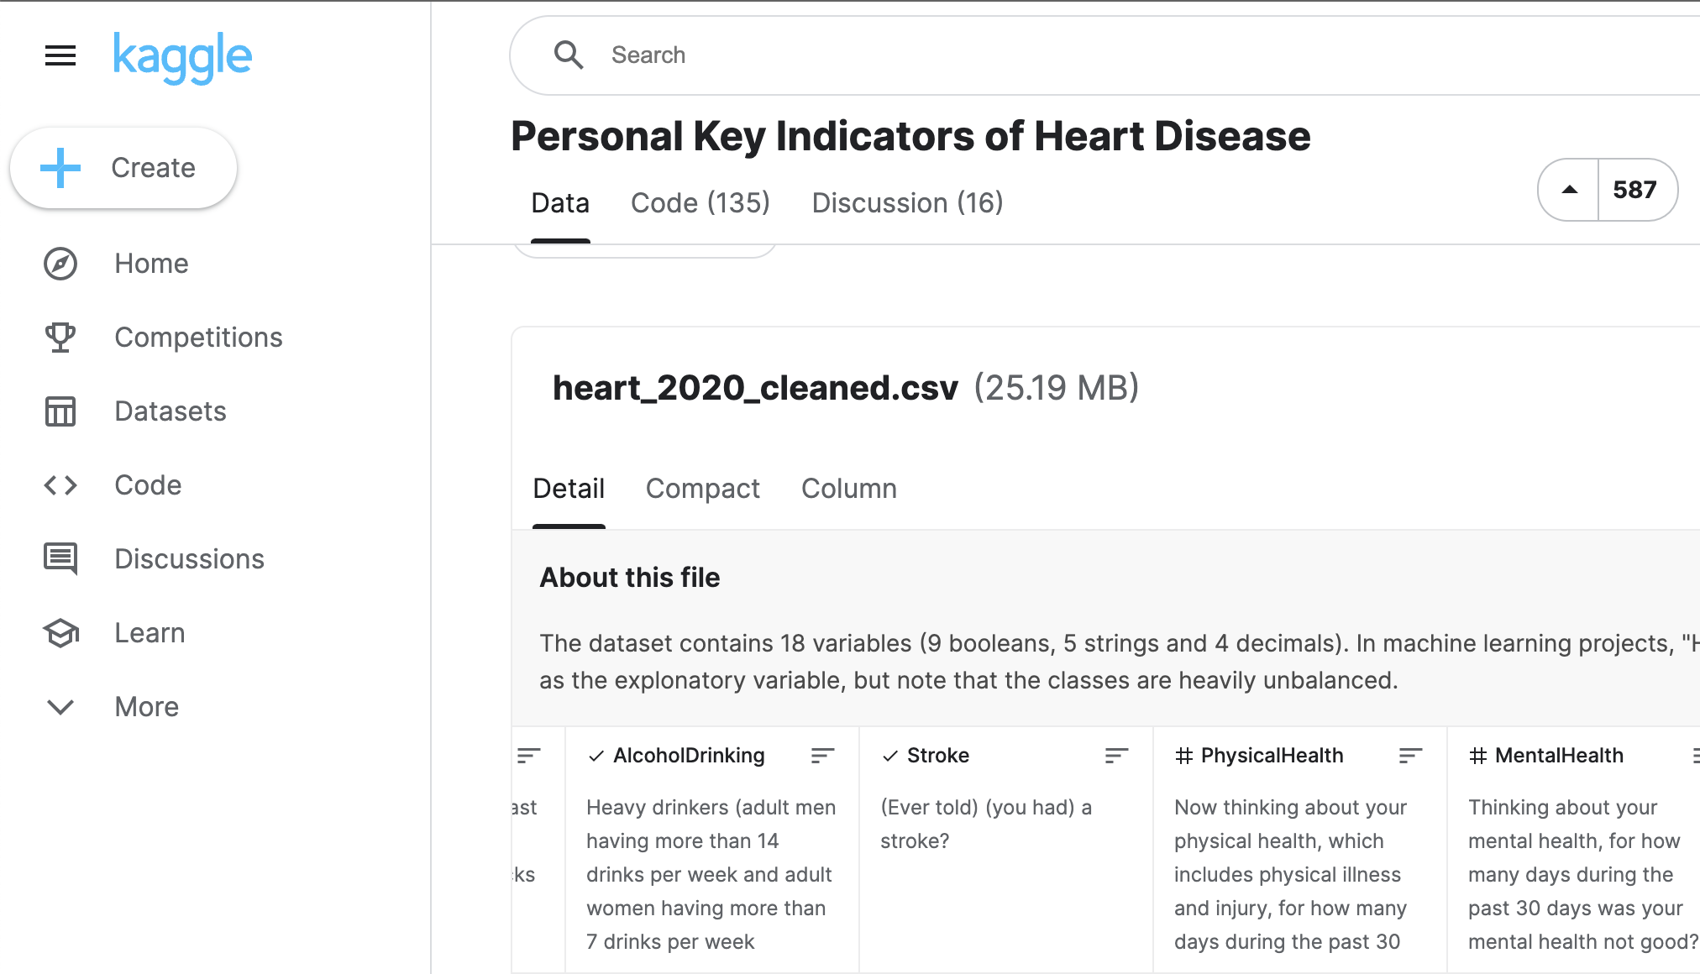

Jing Qiang
Modelling Methodology
Industry Standard & Domain Driven
1
2
3
4
5
Data Collection
From Reputable Sources
[Kaggle, SingStat, WorldBank]
Data Cleaning & Processing
Domain Driven
Data Exploration
Understand Data and
Obtain Insights
Model Training & Optimization
Feature Selection, Hyperparameter Tuning, Feature Importance
Model Evaluation
Select best model based
on Accuracy & Recall Score
Notes:
For all 3 pillars of IntelliLink
Data collection -> reputable sources -> many rows and columns
Data cleaning and processing -> domain driven cleaning and processing (e.g.: the way we handled the N.A. values)
Data Exploration -> Insights and understand the data
Model Training & Optimization -> Feature selection, hyperparameter tuning, feature importance.
Model Evaluation based on Accuracy & Recall Score

Slide 9

Jing Qiang
1. Unified Security through Fraudulent Job Listing Classification
Key Technology
Natural Language Processing
Notes:
Natural Language Processing to Classify Fraudulent Job Listings

Slide 10






Jing Qiang
1. Unified Security through Fraudulent Job Listing Classification
a) Dataset Introduction
Companies
Job Listings
Fraudulent Job Listing Prediction
Company Information
Job Information
Text Data
Company Profile
Has Company Logo
Industry
Job Title
Job Description Location
Department
Salary Range
Requirements
Benefits
Telecommuting
Has Questions
Employment Type
Required Experience
Required Education
Function
Combination of company information and job information

Slide 11
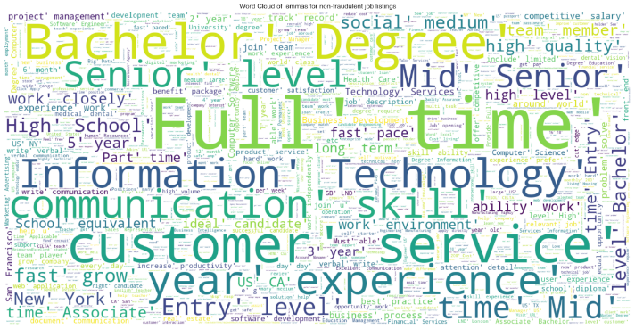
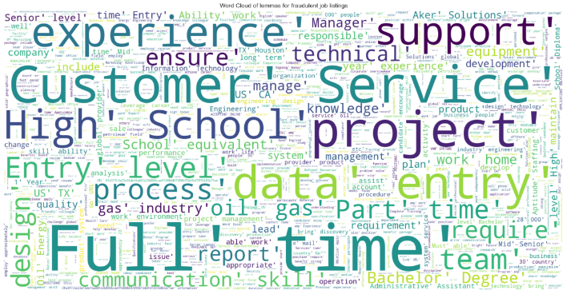
Jing Qiang
1. Unified Security through Fraudulent Job Listing Classification
b) Word Cloud of Job Listings
Non-fraudulent Job Listing
Fraudulent Job Listing
Common words
“Full time”, “bachelor’s degree”, “Information Technology”, and “Senior”
Common words
Entry level”, “data entry”, “high school”, “support”, “project”, and “design”
Notes:
Data collection

Slide 12
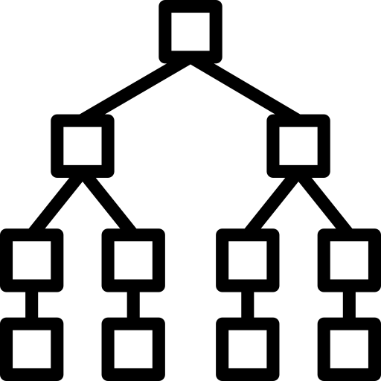
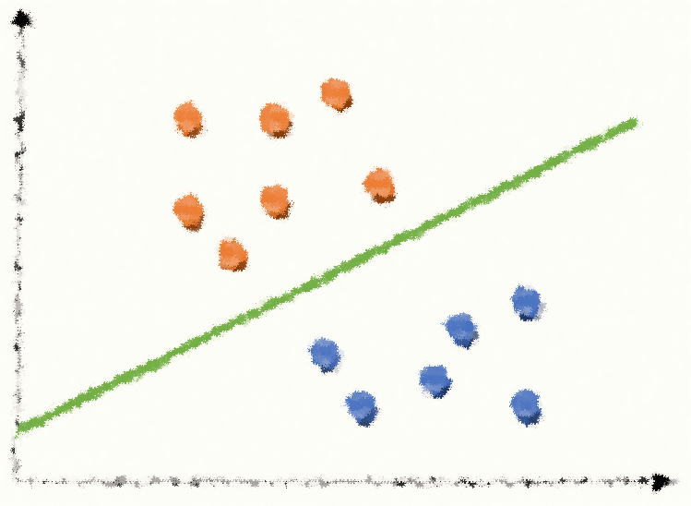

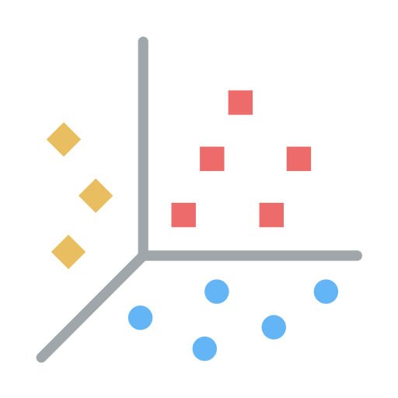
Jing Qiang
1. Unified Security through Fraudulent Job Listing Classification
c) Model Comparison
1
Oversample Train Dataset (SMOTE)
- Incentivise model to predict minority, fraudulent cases
2
Count & TF-IDF Vectorization
- Make text data structured
Random Forest (CV)
Support Vector Classifier (TV)
Logistic Regression (TV)
Multinomial Naïve Bayes Classifier (TV)
Overall Accuracy (> 85%) | 26.04% |  | 88.50% |  | 97.26% |  |  | 89.99%
False Negative Rate (< 30%) | 0.0088% |  | 69.16% |  | 55.07% |  |  | 26.43%
Very Low Accuracy & Very Low FNR
High Accuracy & High FNR
Very High Accuracy & High FNR
High Accuracy & Fairly Low FNR
Notes:
Select MNB with TV

Slide 13
Jing Qiang
1. Unified Security through Fraudulent Job Listing Classification
d) Multinomial Naïve Bayes Classifier with TF-IDF Vectorization – Top Fraudulent Words
Top Fraudulent Words
Ranking | Words
1 | Jacksonville job description administrative
2 | Restaurant manager awarded
3 | Office manager pl
4 | Portland sales need
5 | Philadelphia administrative 21
6 | Welcome require full
7 | Referral director product
8 | Tampa seek individual
9 | Market us md
10 | Even faster full
Notes:
Data collection

Slide 14
Jing Qiang
1. Unified Security through Fraudulent Job Listing Classification
e) Classification Example 1
Job Listing 1
Company: Food52
Title: Marketing Intern
Location: US, NY, New York
Department: Marketing
Salary: -
Company Profile:
We're Food52, and we've created a groundbreaking and award-winning cooking site.
Description:
Reproducing and/or repackaging existing Food52 content for a number of partner sites, such as Huffington Post, Yahoo, Buzzfeed, and more in their various content management systems. Researching blogs and websites for the Provisions by Food52 Affiliate Program…
Not Fraudulent
1
Automatically Flags Suspicious Job Listings
2
Provides Insights on Fraudulent Listings
To make informed decision
3
Collect feedback from employee
To verify classification result
Enhance model for future prediction

Slide 15
Jing Qiang
1. Unified Security through Fraudulent Job Listing Classification
e) Classification Example 2
Job Listing 2
Company: ???
Title: ADMINISTRATIVE & OFFICE ASSISTANT
Location: US, TX, Houston
Department: Unknown
Salary: -
Company Profile: -
Description:
An exciting growth opportunity for an assistant, who will assist in the daily operations (customer service, office assistant, administrative tasks). Ability to multi-task, prioritize and work on a very dynamic and changing environment. Excellent communication skills, written and oral. Attitude to Solve problems, work INDEPENDENTLY and minimum supervision.
Fraudulent
1
Automatically Flags Suspicious Job Listings
2
Provides Insights on Fraudulent Listings
To make informed decision
3
Collect feedback from employee
To verify classification result
Enhance model for future prediction

Slide 16
Jing Qiang
1. Unified Security through Fraudulent Job Listing Classification
e) Classification Example 2
Job Listing 2
Company: ???
Title: ADMINISTRATIVE & OFFICE ASSISTANT
Location: US, TX, Houston
Department: Unknown
Salary: -
Company Profile: -
Description:
Welcome. This is an exciting growth opportunity for an assistant, who will assist in the daily operations (customer service, office assistant, administrative tasks). Entry level role perfect for high school students. Attitude to Solve problems, work INDEPENDENTLY and minimum supervision. Multiple interesting projects to choose from.
Confirm
Fraudulent
OR
Ignore
1
Automatically Flags Suspicious Job Listings
2
Provides Insights on Fraudulent Listings
To make informed decision
3
Collect feedback from employee
To verify classification result
Enhance model for future prediction

Slide 17

David
2. Innovating with Industry Demand Forecasting
Key Technology
Time Series Forecasting

Slide 18
David
2. Innovating with Industry Demand Forecasting
a) Dataset Overview
01
02
Job Vacancy
Industry Skill Demand Dataset
Singapore
Global Context
Collected from Government Website
Collected from WorldBank
Time Range
Time Range
2006 April – 2022 July by quarter
2015 – 2019 by year
Industry
Industry
43 industries
70 industries
Job Vacancy
Skill Rank

Slide 19

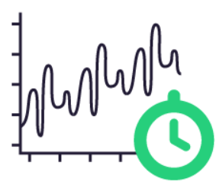

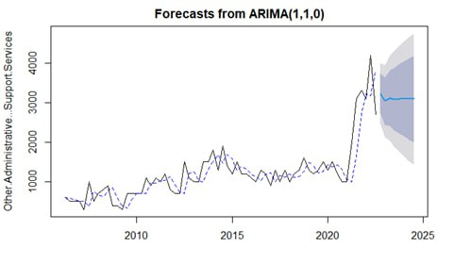
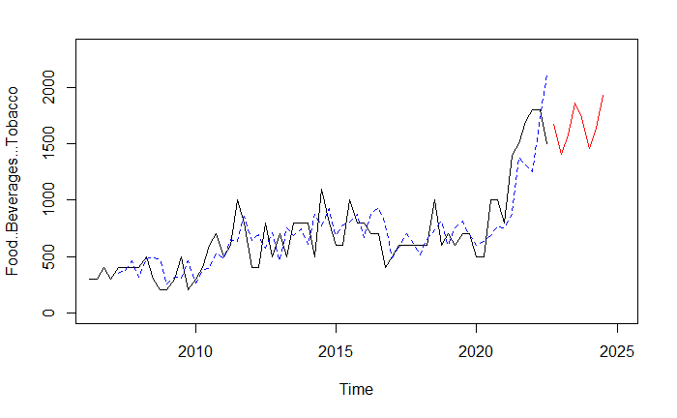
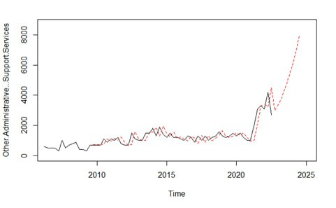
David
2. Innovating with Industry Demand Forecasting
b) Development of Analytics Tool on Job Vacancy Dataset
ARIMA
Holt-Winters
Taylor Expansion
RMSE | 382.84 |  | 1485.79 |  | 452.39
MAPE | 0.2107 |  | 2.6021 |  | 0.2499
MDA | 0.6366 |  | 0.4536 |  | 0.6341
Decision
NOT chosen due to
invalid assumption
NOT chosen due to
worst performance
Chosen due to interpretability & good performance
Forecasted Plot

Slide 20

David
2. Innovating with Industry Demand Forecasting
c) Model Evaluation
Assumptions & Interpretability
Example
1. Context: Cloud services industry experienced a boom in the last year
Demand in Cloud Services
ARIMA
Assumes stationary underlying process
e.g., effect of COVID-19 resulting in the coefficients estimated by the ARIMA model irrelevant by fitting on past data
2. Model predicts next year will have a similar boom, thus more job vacancies are expected
Taylor Expansion
3. External information: Investment in start-ups been drying up due to a slowdown in technological breakthroughs
Flexible & interpretable, allow users to incorporate external factors
e.g., changes in government policies or natural disaster
4. User can update his prior belief if he thinks that the underlying model assumption that the trend will continue is invalidated by external information

Slide 21
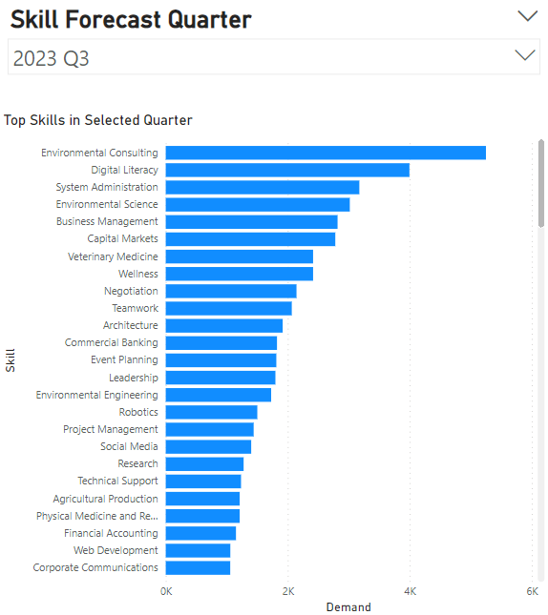
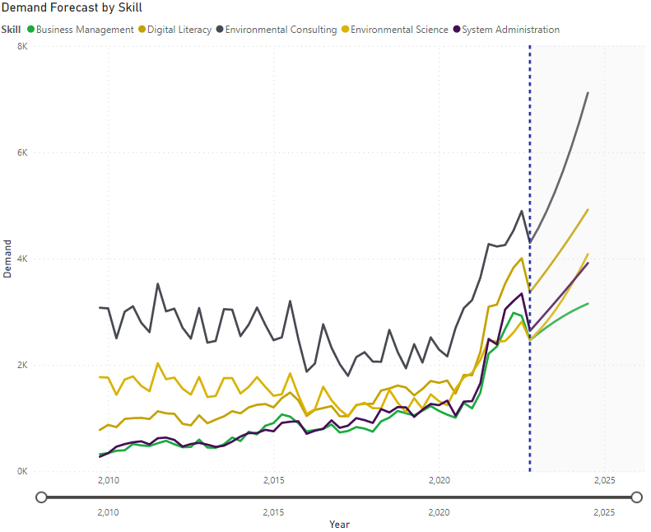
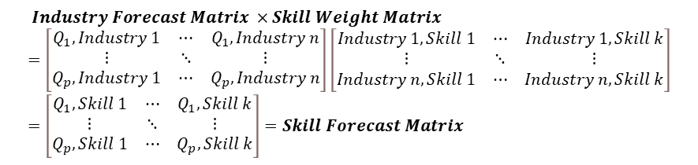
David
2. Innovating with Industry Demand Forecasting
d) Project Job Vacancy Demand to Skill Demand
$$Industry Forecast Matrix ×Skill Weight Matrix =\left[\begin{matrix}Q_{1}, Industry 1 & ⋯ & Q_{1}, Industry n \\ ⋮ & ⋱ & ⋮ \\ Q_{p}, Industry 1 & ⋯ & Q_{p}, Industry n\end{matrix}\right]\left[\begin{matrix}Industry 1, Skill 1 & ⋯ & Industry 1, Skill k \\ ⋮ & ⋱ & ⋮ \\ Industry n, Skill 1 & ⋯ & Industry n, Skill k\end{matrix}\right]=\left[\begin{matrix}Q_{1}, Skill 1 & ⋯ & Q_{1}, Skill k \\ ⋮ & ⋱ & ⋮ \\ Q_{p}, Skill 1 & ⋯ & Q_{p}, Skill k\end{matrix}\right]=Skill Forecast Matrix$$
1
Exclusive Insights Sharing
Publish reports on the most in-demand skills for different industries
2
Skill development
Develop relevant training courses on Linked Leaning
Seize business opportunities
3
Market Analysis
Used by companies to inform their hiring and training strategies

Slide 22

Jiang Lei
3. Enhancing Effectiveness through Passive Jobseeker Identification
Key Technology
Machine Learning Classification

Slide 23



Jiang Lei
3. Enhancing Effectiveness through Passive Jobseeker Identification
a) Dataset Introduction
Job Seeker Prediction – willingness of changing jobs
U.S. employees
Personal Information
Demographical Variables
Education History
Employment History
Gender
City Code
City Development Index
Enrolled University
No enrollment/ part-time/ full-time
Major Discipline
Arts/ Business/ Humanities/ STEM
Level of Education
Highest level of education attainment
Total Training Hours
Years of experience
Relevant Experience
Last New Job
No. of years between previous and current job
Company Size
Company Type

Slide 24


Jiang Lei
3. Enhancing Effectiveness through Passive Jobseeker Identification
b) Model Comparison
1
Hyperparameter Tuning
- Looking for best performer
2
Reduced Features (8)
- Adapt to incomplete user profiles in business context.
3
Cross Validation
- Ensure Consistency & Stability
Support Vector Machine
Logistic Regression
Classification
& Regression Trees
Extreme
Gradient
Boosting
Random Forest
Overall Accuracy (> 90%) | 79.95% |  | 86.56% |  | 90.08% |  | 91.44% |  | 91.14%
False Negative Rate | 21.19% |  | 12.37% |  | 18.17% |  | 17.32% |  | 16.47%
Recall | 78.81% |  | 87.63% |  | 81.83% |  | 82.68% |  | 83.53%
Worst FNR
Lowest Accuracy & Lowest Recall
Best FNR
Low Accuracy & Highest Recall
Poor FNR
High Accuracy & Fair Recall
Poor FNR
Highest Accuracy & Fair Recall
Fair FNR
High Accuracy & Fair Recall

Slide 25
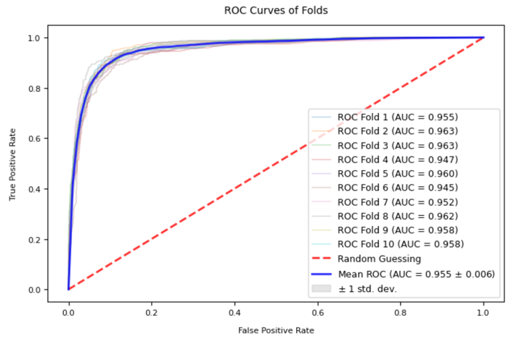
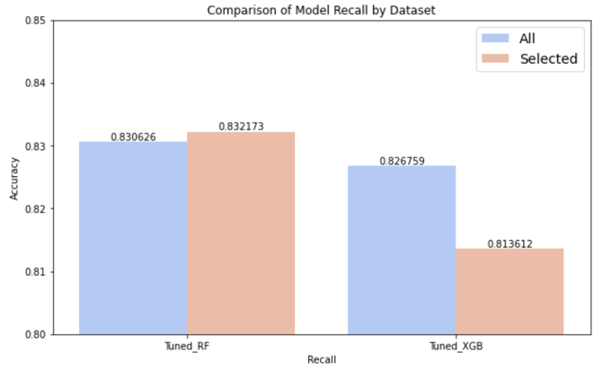
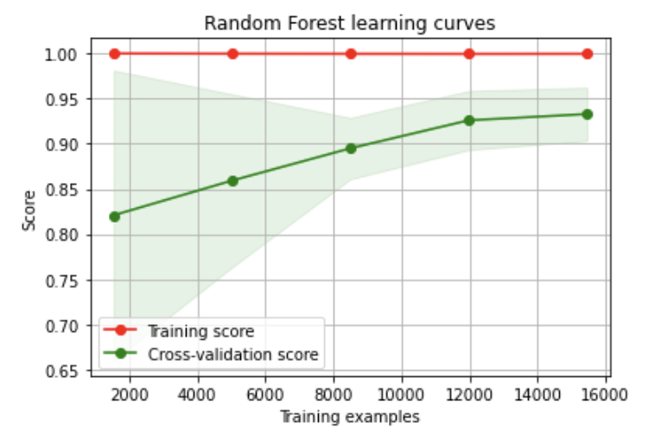
Jiang Lei
3. Enhancing Effectiveness through Passive Jobseeker Identification
c) Selected Model Evaluation – random forest on 8-feature dataset
Analytic Insights
Stable performance with low standard deviation across different folds
Best Performer on both initial and selected dataset
Expected to perform well on unseen data when trainset size increases
Business Implication
Recruiter can confidentially count on the model’s prediction of job seekers who are most likely to accept their job offers
Despite incomplete profile information, the model can robustly predict whether he/she is a potential jobseeker
To gather more data, recruiters be prompted to select whether the predicted user is a genuine jobseeker, to feedback model

Slide 26
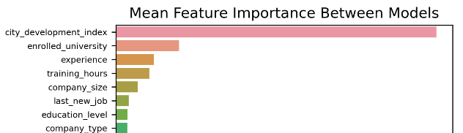
Jiang Lei
3. Enhancing Effectiveness through Passive Jobseeker Identification
d) What user profile information should be prioritized for collection?
1
Geographical Data
2
Education Experience
3
Employment History
City development index
(Most significant predictor)
Enrolled university type
Education level
Previous work experience
Current company size
Type of company
Hours of training
Time elapsed since last job change
Decision:
Incorporate a dynamically updated dataset for mapping location to development index
Remind users of updating their locations
Decision:
Ensure the accuracy of users' educational profiles
Detect overlapping timeline & mismatched information.
Provide supporting educational documentation if necessary
Decision:
Verify job experiences through company email
Monitor for suspicious activity or inconsistencies in employment history

Slide 27


Jiang Lei
3. Enhancing Effectiveness through Passive Jobseeker Identification
e) Prediction Example
Profile 1
Gender: Male
Location: New York City
Profile 2
Gender: Female
Location: Portland
 | Background Information |  | Background Information
Enrolled university type | Full-time |  | Part time
Education level | Graduate |  | Graduate
Previous work experience | 14 years |  | 19 years
Current company size | 500-999 |  | 5000-9999
Type of company | Private Limited |  | Private Limited
Hours of training | 148 |  | 141
Time elapsed since last job change | 1 year |  | > 4 years
Jobseeker Score | 98% (Recommended to Recruiter) |  | 54% (In the rec list, but not in the front page)

Slide 28
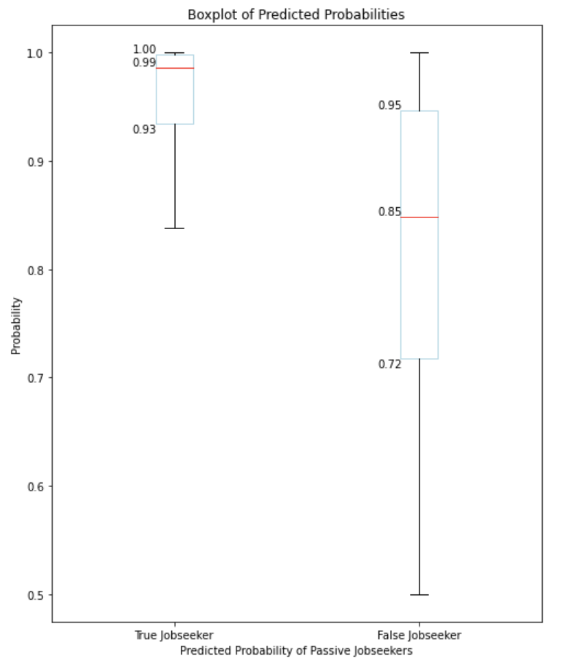
Jiang Lei
3. Enhancing Effectiveness through Passive Jobseeker Identification
e) Prediction Example
1
Recommendation Priority
Recommend profiles for recruiters with prediction probability >0.95
Sort recommendation by probability
Gender: Male
Location: New York City
 | Background Information
Enrolled university type | Full-time
Education level | Graduate
Previous work experience | 14 years
Current company size | 500-999
Type of company | Private Limited
Hours of training | 148
Time elapsed since last job change | 1 year
Jobseeker Score | 98% (Recommended to Recruiter)
2
Reveal Details for Recruiter
To make informed decision combined with recruiter’s experience
Tailored offer: an experienced individual who has recently started a new job and may be seeking improved compensation packages
3
Collect feedback from recruiter to verify prediction result
“May I have more details about this position” -> genuine jobseeker
No / Negative response -> wrongly prediction
Feedback to model for enhancements

Slide 29
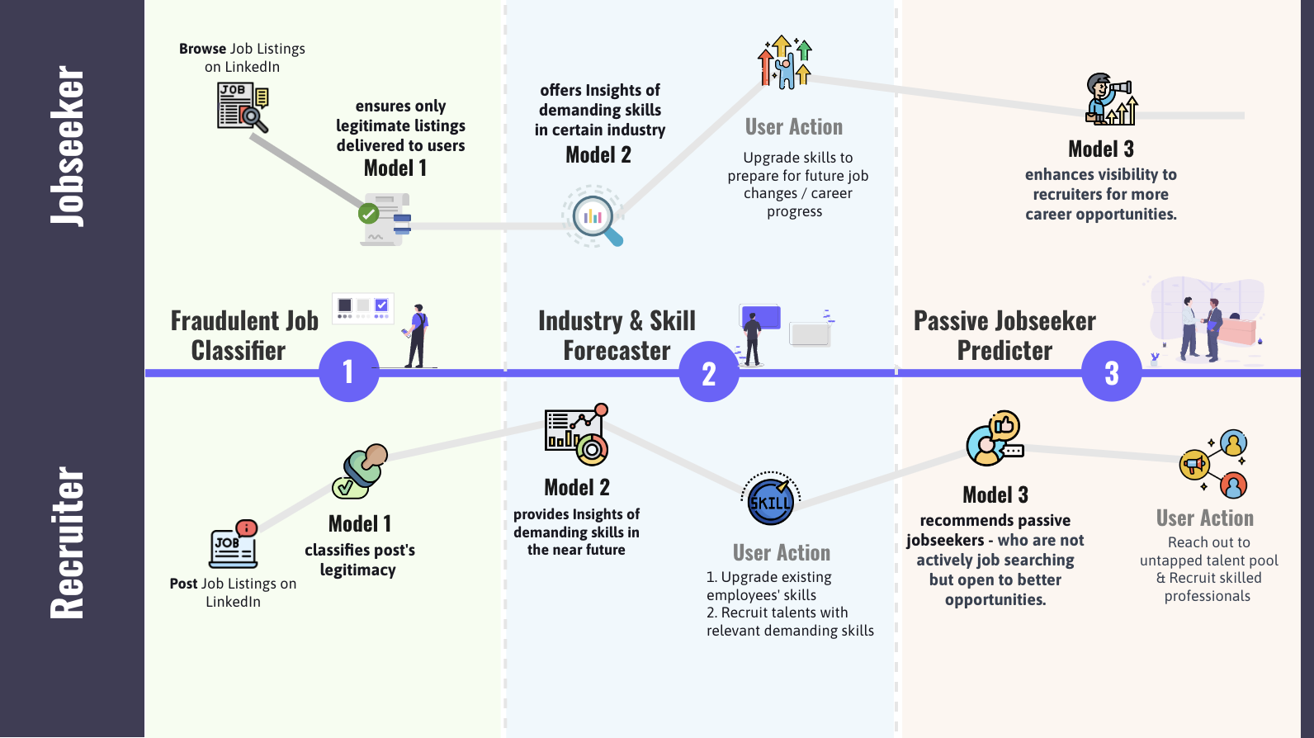
Jiang Lei
Business Implementation
How will IntelliLink achieve the goals outlined in LinkedIn's Opportunity Statement?

Slide 30




Business Implementation
How can IntelliLink models integrated to LinkedIn Services?
How can our IntelliLink models optimize LinkedIn Services?
1
2
3
Talent Solutions division
LinkedIn Learning
Premium Subscription
Safeguard Users from Job Scam
Provide Exclusive Industry Insights & Tailored Skill Training
Premium Head-Hunter Service

Slide 31
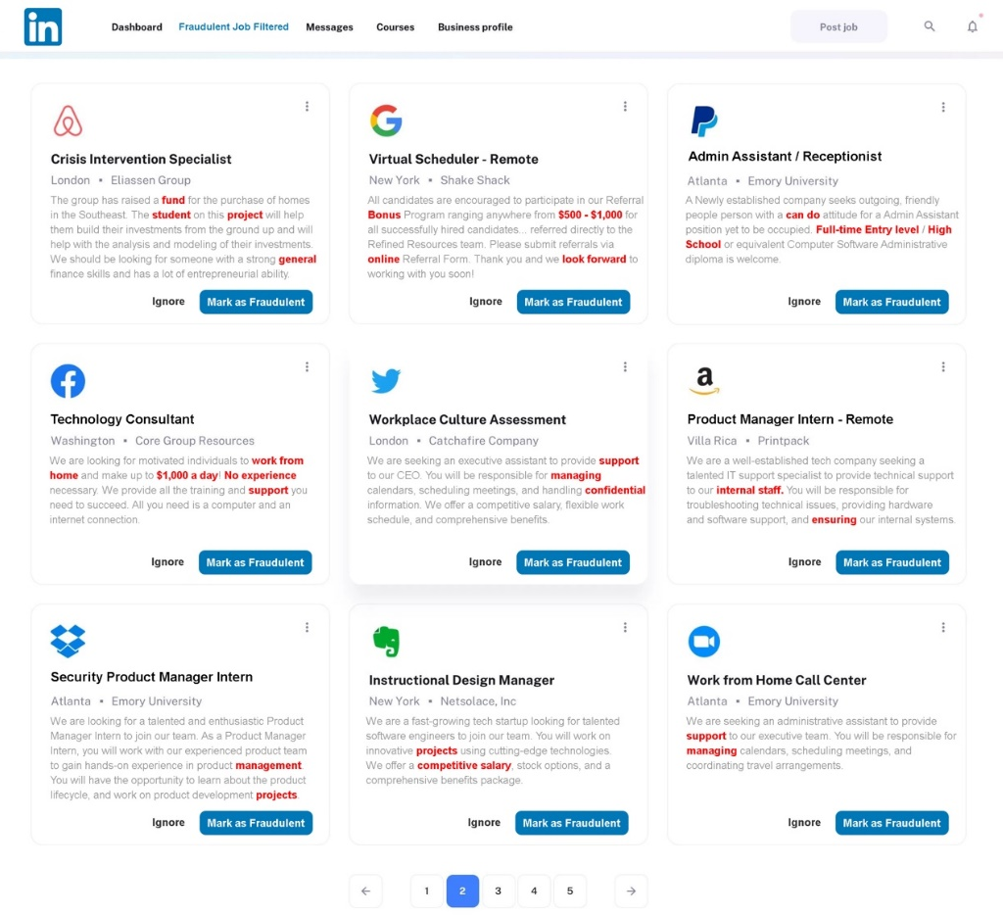
Jiang Lei
Business Implementation
1: Safeguard Users from Job Scam
01
Auto-detected fraudulent listings were sent to the admin for prompt review
02
Suspicious keywords highlighted for easy identification
03
If an account has three flagged posts, it will be suspended.
04
Retrain the model on misclassified listings
Rigorously improve model's capability to effectively combat the ceaseless influx of job scams

Slide 32
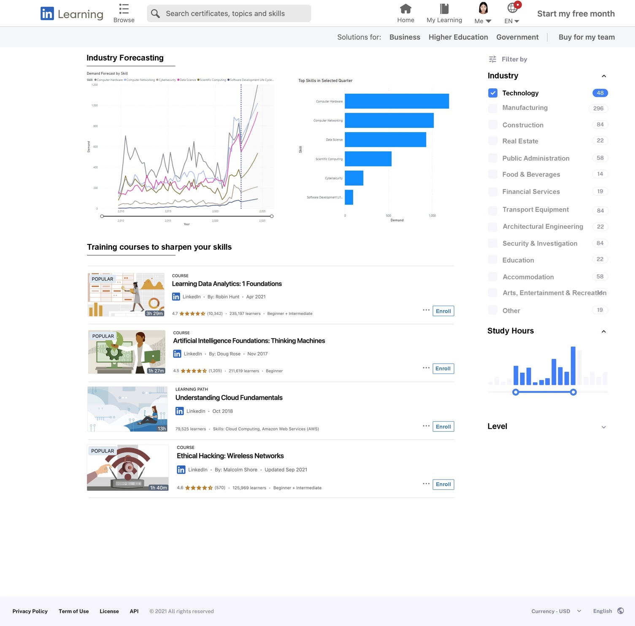



Jiang Lei
Business Implementation
2: Provide Exclusive Industry Insights & Tailored Skill Training
Provide insight into future skill demand
Market understanding for jobseekers
Adaptive recruitment strategies for recruiters
Offer relevant training courses
Remain resilient in an ever-evolving industry by constant upskilling
Enhance course attractiveness & introduce new courses
Optimize Forecasting Model
Collect employer feedback to supplement forecasting model (e.g., skill demand accuracy, pre-planning effectiveness).

Slide 33
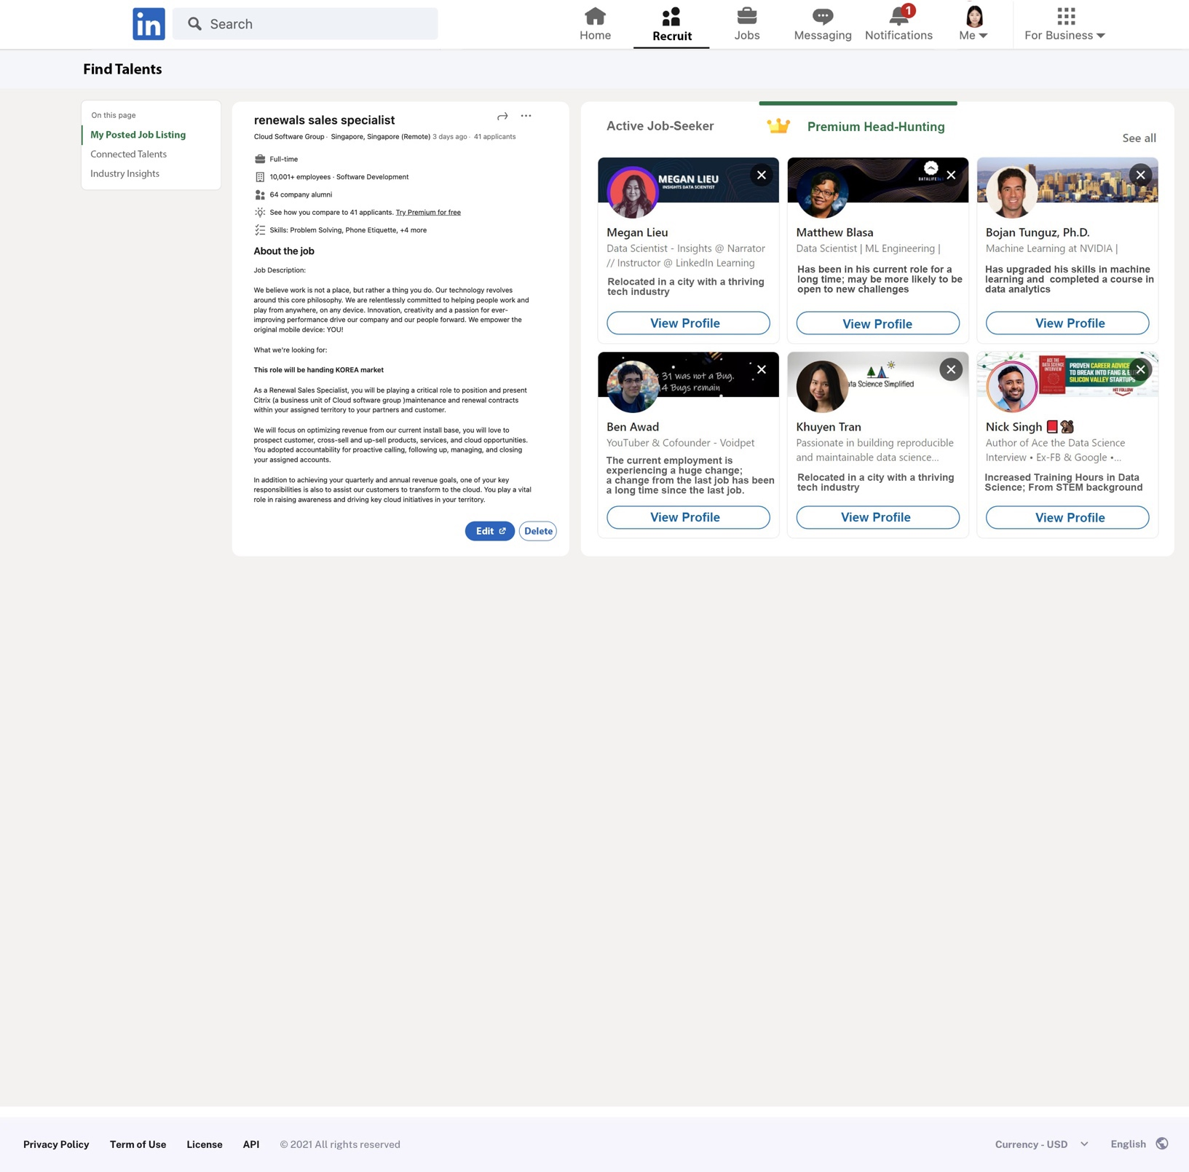
Jiang Lei
Business Implementation
3: Premium Head-Hunting Service
Premium Head-Hunting feature for Recruiter
Recommend potential job seekers identified by model, sorted by predicted probability.
Provide insights on reasons for a candidate's job change willingness.
Understand the candidate's motivations and provide a more tailored offer
Negative & Proactive candidates will be feedbacked to model for enhancement
- After reach out, the recruiter checks if candidate seeks job change and feedback to system

Slide 34
Jiang Lei
Expected Business Outcomes
01
Address common recruiting pain points
Boost Revenue Stream
03
Secure 58 million companies & 57% of job seekers from scams
Bridge talent gap by offering in-demand upskilling courses.
Headhunting premium feature (new)
Improve the success rate of hiring highly qualified candidates
Increase Recruiter Lite subscription rates
LinkedIn Learning
Increase course enrolment by tapping into a large untapped user base
Expand business by providing more relevant courses based on forecasted in-demand skills
Partner with employers.
Effectiveness
Security
02
Enhance LinkedIn’s Work Efficiency
Innovation
Automate detection of suspicious job postings
Ensure efficiency despite a surge in listings, seekers, and recruiters.
-

Slide 35





Ken
Future Improvements
Limitations and Concerns
Limitations
Example
Mitigating Strategies
Potential Bias
Constantly collect & update data
Ensuring dataset is diverse & representative
Monitor & gather user feedback regularly
Individuals from certain background more likely to be visible to recruiters.
Only certain types of scams identified

Slide 36


Ken
Future Improvements
Limitations and Concerns
Limitations
Example
Mitigating Strategies
Potential Bias
Constantly collect & update data
Ensuring dataset is diverse & representative
Monitor & gather user feedback regularly
Individuals from certain background more likely to be visible to recruiters.
Only certain types of scams identified
Privacy Concerns
Vast amount of user data collected to predict if the user is a job seeker
Risk of data leakage
Only collect necessary data
Ensure transparency in data collection

Slide 37


Ken
Future Improvements
Limitations and Concerns
Limitations
Example
Mitigating Strategies
Potential Bias
Constantly collect & update data
Ensuring dataset is diverse & representative
Monitor & gather user feedback regularly
Individuals from certain background more likely to be visible to recruiters.
Only certain types of scams identified
Privacy Concerns
Vast amount of user data collected to predict if the user is a job seeker
Risk of data leakage
Only collect necessary data
Ensure transparency in data collection
Inaccurate User Information
Provide more detailed instructions for user input
Outlier detection to filter potentially inaccurate information
Users entering incorrect information
Users failing to update their profiles

Slide 38

Ken
Future Improvements
How can our models be further improved?
Enhancing Model Accuracy
Prediction Model | Enhancements
 | Utilise additional predictor variables Hyperparameter tuning to maximise models’ capabilities Alternative word embedding technique – Word2Vec
 | 1. Increase number of data sources 2. Utilise more sophisticated time series models
 | 1. Take advantage of LinkedIn’s extensive user database 2. Incorporate more pertinent and useful data to provide greater transparency in prediction
Fraudulent
Job Listing Filter
Industry Trend Forecasting
Passive Jobseeker Prediction

Slide 39
Ken
Future Improvements
Further Considerations
Localising Data to LinkedIn
Detecting and Removing Fake Profiles and Information
Improving Users’ Trust
01
Retrain the machine learning models using LinkedIn- specific data
Presence of fake profiles and inaccurate information
01
Machine Learning models are “black boxes”
01
02
Enhances the models’ prediction accuracy
02
02
Detection can mitigate impact of false or misleading data
Users may find it difficult to trust the predictions
03
Results are more reliable and applicable to LinkedIn’s context
03
Implement a model interpreter, such as SHAP (SHapley Additive explanation)
03
Ensure that IntelliLink’s models perform accurately and reliably
04
Maintain LinkedIn’s credibility

Slide 40


Ken
Future Improvements
Ending Remarks
+ Advantages
+ Enhancements
Machine Learning Models
Fraudulent
Job Listing Filter
Industry Trend Forecasting
Passive Jobseeker Prediction
Enhanced Recruiting Experience
Increased Business Profits
Improved Efficiency
Strengthened Recruitment Security

